Slide 1
LAB 5 (/5 Marks)
Using a linear search (linear search method/function), write a C program to search an element from an array of 10 elements (integer array) initialized from the start of the program.

Slide 2
LINKED LIST, STACKS AND QUEUE
Introduction to Data Structures
A data structure is a way of storing data in a computer so that it can be used efficiently.
The choice of the data structure begins from the choice of an abstract data type (ADT).
ADT is a logical description of how we view the data and the operations that are allowed without regard to how they will be implemented.

Slide 3
LINKED LIST, STACKS AND QUEUE
A well-designed data structure allows a variety of critical operations to be performed, using as
few resources,
both execution time and
memory space, as possible.

Slide 4
LINKED LIST, STACKS AND QUEUE
Data structure introduction refers to a scheme for organizing data, or
it is an arrangement of data in computer's memory in such a way that it could make the data quickly available
to the processor for required calculations.

Slide 5
LINKED LIST, STACKS AND QUEUE
A data structure has two fundamental concerns:
First, how the data will be stored, and
Second, what operations will be performed on it.
The way in which the data is organized affects the performance of a program for different tasks.

Slide 6
LINKED LIST, STACKS AND QUEUE
Computer programmers decide which data structures to use based on the nature of the data and
the processes that need to be performed on that data.

Slide 7
LINKED LIST, STACKS AND QUEUE
Examples of commonly used data structures include
lists,
arrays,
stacks,
queues,
trees, and
graphs.

Slide 8
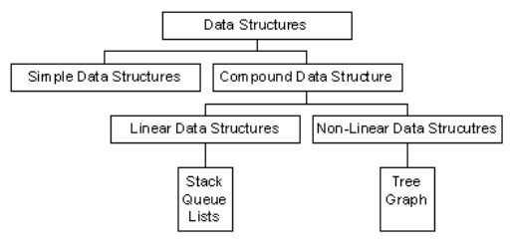
LINKED LIST, STACKS AND QUEUE
Data structures can be classified as:
Simple data structure
Compound data structure
Linear data structure
Non linear data structure

Slide 9
LINKED LIST, STACKS AND QUEUE
Simple Data Structure
They are constructed with the help of primitive data structure.
A primitive data structure is used to represent the standard data types of any one of the computer languages.

Slide 10
LINKED LIST, STACKS AND QUEUE
Examples of primitive data structures are:
Variables,
arrays,
pointers,
structures and etc.

Slide 11
LINKED LIST, STACKS AND QUEUE
Compound Data structure
These are constructed with the help of any one of the primitive data structure and it has a specific functionality.
It can be designed by user, and it is classified as:
Linear data structure
Non-linear data structure

Slide 12
LINKED LIST, STACKS AND QUEUE
Linear Data Structure
They are constructed as a continuous arrangement of data elements in the memory
by using array data type.
In the linear Data Structures, the relationship of adjacency is not maintained between the data elements.

Slide 13
LINKED LIST, STACKS AND QUEUE
Operations applied on linear data structure are:
Add an element
Delete an element
Traverse
Sort the list of elements
Search for a data element

Slide 14
LINKED LIST, STACKS AND QUEUE
For examples of linear data structure are:
Stack,
Queue,
Tables,
List, and
Linked Lists.

Slide 15
LINKED LIST, STACKS AND QUEUE
Non-linear Data Structure
They are constructed as a collection of randomly distributed set of data item joined together
by using a special pointer (tag).
In non-linear Data structure, the relationship of adjacency is maintained between the data items.

Slide 16
LINKED LIST, STACKS AND QUEUE
Operations applied on non-linear data structures are:
Add elements
Delete elements
Display the elements
Sort the list of elements
Search for a data element

Slide 17
LINKED LIST, STACKS AND QUEUE
Example s of non-linear data structures are:
Tree,
Decision tree,
Graph, and etc

Slide 18
LINKED LIST, STACKS AND QUEUE
Linked List Concepts
A linked list is a non-sequential collection of data items.
It is a dynamic data structure.
For every data item in a linked list, there is an associated pointer that would give the memory location of the next data item in the linked list.

Slide 19
LINKED LIST, STACKS AND QUEUE
The data items in the linked list are not in consecutive memory locations.
They may be anywhere, but the accessing of these data items is easier as each data item contains the
address of the next data item.

Slide 20
LINKED LIST, STACKS AND QUEUE
Types of Linked Lists
Basically, linked lists is in four types:
Single Linked List
Double Linked List
Circular Linked List
Circular Double Linked List.

Slide 21
LINKED LIST, STACKS AND QUEUE
Single linked list
A single linked list is one in which all nodes are linked together in some sequential manner.
A linked list allocates space for each element separately in its own block of memory called a "node".

Slide 22
LINKED LIST, STACKS AND QUEUE
The list gets an overall structure by using pointers to connect all its nodes together like the links in a chain.
Each node contains two fields; a "data" field to store whatever element, and
a "next" field which is a pointer used to link to the next node.

Slide 23
LINKED LIST, STACKS AND QUEUE
The front of the list is a pointer to the “start” node.
The beginning of the linked list is stored in a "start" pointer which points to the first node.
The first node contains a pointer to the second node.
The second node contains a pointer to the third node, and so on.

Slide 24
LINKED LIST, STACKS AND QUEUE
The basic operations in a single linked list are:
Creation
Insertion
Deletion
Traversing

Slide 25
LINKED LIST, STACKS AND QUEUE
Creating a node for Single Linked List
Creating a singly linked list starts with creating a node.
Sufficient memory has to be allocated for creating a node.
The information is stored in the memory.

Slide 26
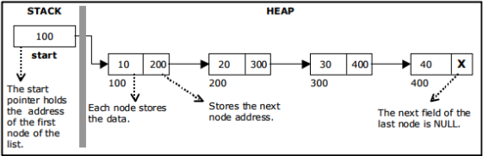
LINKED LIST, STACKS AND QUEUE

Slide 27
LINKED LIST, STACKS AND QUEUE
Insertion of a Node
One of the most primitive operations that can be done in a singly linked list is the insertion of a node.
Memory is to be allocated for the new node (in a similar way that is done while creating a list) before reading the data.

Slide 28
LINKED LIST, STACKS AND QUEUE
The new node can then be inserted at three different places:
Inserting a node at the beginning
Inserting a node at the end
Inserting a node at intermediate position

Slide 29
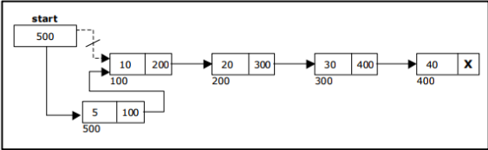
LINKED LIST, STACKS AND QUEUE
Inserting a node at the beginning

Slide 30
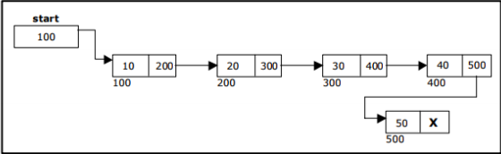
LINKED LIST, STACKS AND QUEUE
Inserting a node at the end:

Slide 31
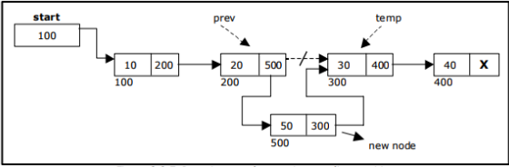
LINKED LIST, STACKS AND QUEUE
Inserting a node into the single linked list at a specified intermediate position other than beginning and end;

Slide 32
LINKED LIST, STACKS AND QUEUE
A node can be deleted from the list from three different places;
Deleting a node at the beginning
Deleting a node at the end
Deleting a node at intermediate position.

Slide 33
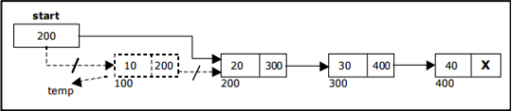
LINKED LIST, STACKS AND QUEUE
Deleting a node at the beginning

Slide 34
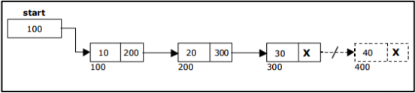
LINKED LIST, STACKS AND QUEUE
Deleting a node at the end:

Slide 35
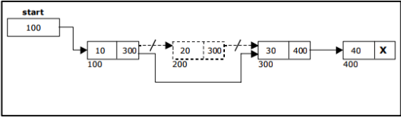
LINKED LIST, STACKS AND QUEUE
Deleting a node at Intermediate position:
The following steps are followed, to delete a node from an intermediate position in the list (List must contain more than two node).

Slide 36
LINKED LIST, STACKS AND QUEUE
Double linked list
A double linked list is one in which all nodes are linked together by multiple links which helps
in accessing both the successor node (next node) and predecessor node (previous node) from any arbitrary node within the list.

Slide 37
LINKED LIST, STACKS AND QUEUE
Therefore, each node in a double linked list has two link fields (pointers) to point to the left node (previous) and the right node (next).
Each node contains three fields:
Left link
Data
Right link

Slide 38
LINKED LIST, STACKS AND QUEUE
The left link points to the predecessor node and
the right link points to the successor node.
The data field stores the required data.

Slide 39
LINKED LIST, STACKS AND QUEUE
The basic operations in a double linked list are:
Creation
Insertion
Deletion
Traversing

Slide 40
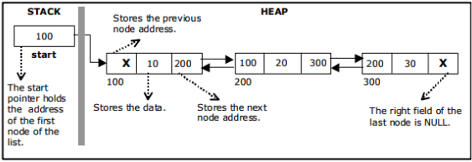
LINKED LIST, STACKS AND QUEUE
A double linked list is shown as;

Slide 41
LINKED LIST, STACKS AND QUEUE
The beginning of the double linked list is stored in a "start" pointer which points to the first node.
The first node’s left link and last node’s right link is set to NULL.

Slide 42
LINKED LIST, STACKS AND QUEUE
Creating a node for Double Linked List
Creating a double linked list starts with creating a node.
Sufficient memory has to be allocated for creating a node.
The information is stored in the memory.

Slide 43
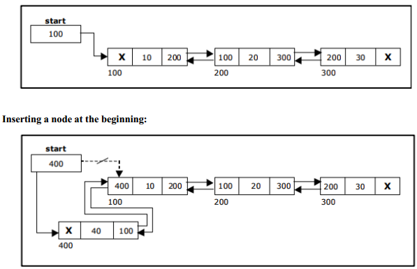
Double Linked List with 3 nodes;

Slide 44
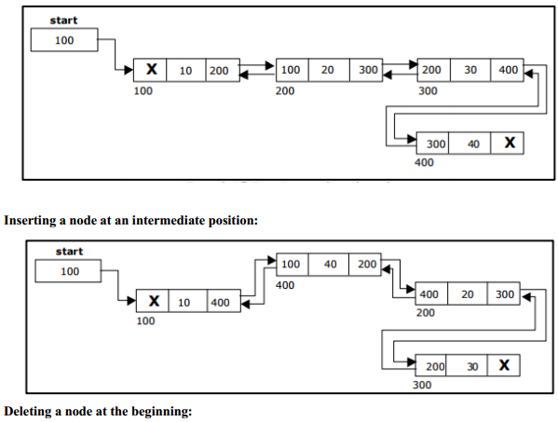
Inserting a node at the end;

Slide 45
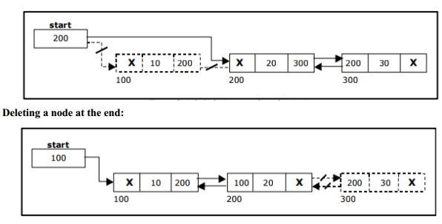

Slide 46
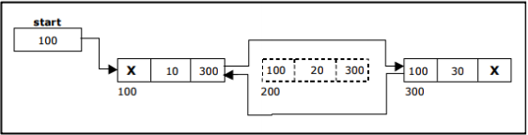
LINKED LIST, STACKS AND QUEUE
Deleting a node at Intermediate position;

Slide 47
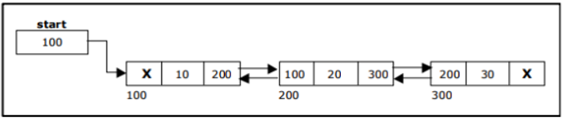
LAB 6
1. Using a Single linked list, below:
a) Add new node with 70 data and 700 address in the middle. b) Delete a node with address 100 from the list.
1. Using a Double linked list, below:
a) Add new node with 50 data and 700 address in the beginning. b) Delete a node with address 200 from the list.

Slide 48
LINKED LIST, STACKS AND QUEUE
Circular linked list
A circular linked list is one, which has no beginning and no end.
A single linked list can be made a circular linked list by simply storing address of the very first node in the link field of the last node.

Slide 49
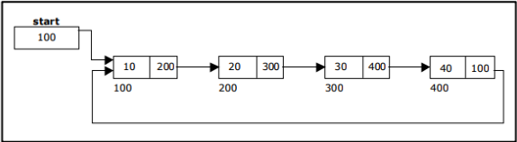
LINKED LIST, STACKS AND QUEUE
Creating a circular single Linked List with “n‟ number of nodes;

Slide 50
LINKED LIST, STACKS AND QUEUE
The basic operations in a circular single linked list are;
Creation
Insertion
Deletion
Traversing.

Slide 51
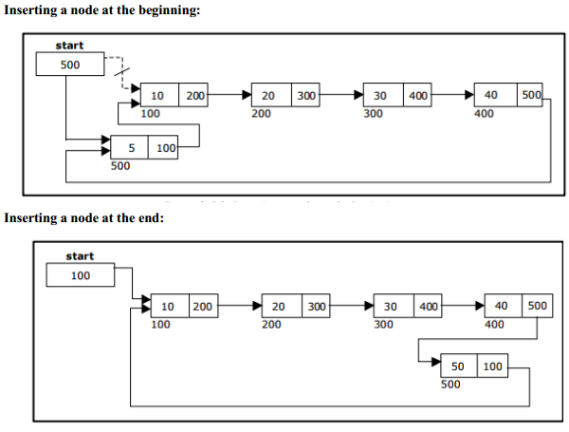

Slide 52
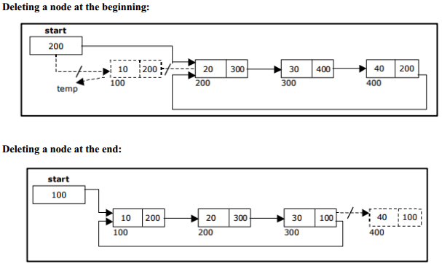

Slide 53
LINKED LIST, STACKS AND QUEUE
Circular double linked list
A circular double linked list is one, which has both the successor pointer and predecessor pointer in the circular manner.
The objective behind considering circular double linked list is to simplify the insertion and deletion operations performed on double linked list.

Slide 54
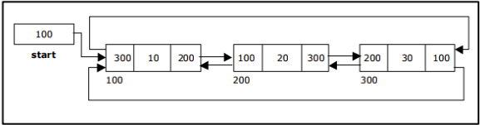
LINKED LIST, STACKS AND QUEUE
In circular double linked list, the right link of the right most node points back to the start node and
left link of the first node points to the last node.
A circular double linked list is shown as;

Slide 55
LINKED LIST, STACKS AND QUEUE
The basic operations in a circular double linked list are:
Creation
Insertion
Deletion
Traversing

Slide 56
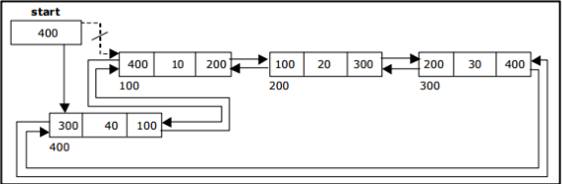
LINKED LIST, STACKS AND QUEUE
Inserting a node at the beginning:

Slide 57
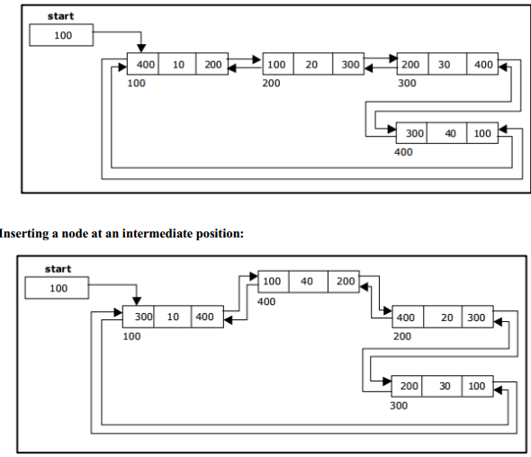
Inserting a node at the end;

Slide 58
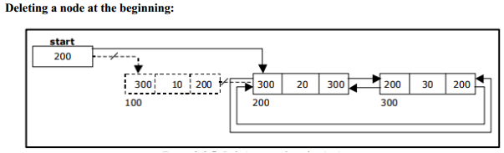
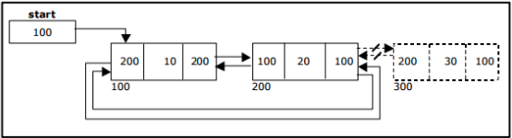
Deleting a node at the end;

Slide 59
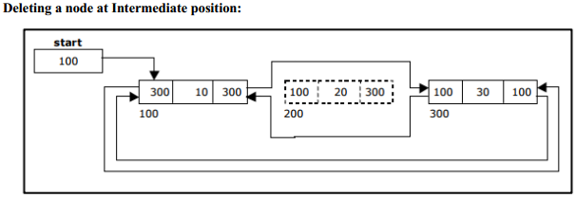
LINKED LIST, STACKS AND QUEUE

Slide 60
LINKED LIST, STACKS AND QUEUE
Stacks Primitive Operations
A stack is a container of objects that are inserted and removed according to the last-in first-out (LIFO) principle.
In the pushdown stacks only two operations are allowed:
push the item into the stack, and
pop the item out of the stack.

Slide 61
LINKED LIST, STACKS AND QUEUE
A stack is a limited access data structure, elements can be added and removed from the stack only at the top.
Push adds an item to the top of the stack, pop removes the item from the top.

Slide 62
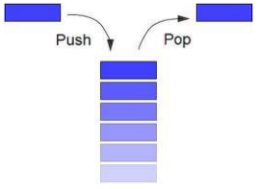
LINKED LIST, STACKS AND QUEUE
A helpful analogy is to think of a stack of books; you can remove only the top book,
also you can add a new book on the top.

Slide 63
LINKED LIST, STACKS AND QUEUE
The add operation of the stack is called push operation
The delete operation is called as pop operation.
Push operation on a full stack causes stack overflow.
Pop operation on an empty stack causes stack underflow.

Slide 64
LINKED LIST, STACKS AND QUEUE
SP is a pointer, which is used to access the top element of the stack.
If you push elements they are added on top of the stack;
In the same way, when we pop the elements, the element at the top of the stack is deleted.

Slide 65
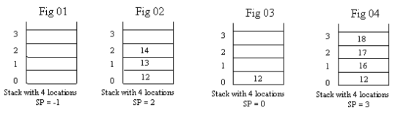
LINKED LIST, STACKS AND QUEUE
There are two operations applied on stack, they are;
Push
pop

Slide 66
LINKED LIST, STACKS AND QUEUE
While performing push & pop operations, the following test must be conducted on the stack;
Stack is empty or not
Stack is full or not

Slide 67
LINKED LIST, STACKS AND QUEUE
Push
Push operation is used to add new elements in to the stack.
At the time of addition, first check the stack if it is full or not.
If the stack is full, it generates an error message "stack overflow".

Slide 68
LINKED LIST, STACKS AND QUEUE
Pop
Pop operation is used to delete elements from the stack.
At the time of deletion, it first check the stack if it is empty or not.
If the stack is empty it generates an error message "stack underflow".

Slide 69
LINKED LIST, STACKS AND QUEUE
Representation of a Stack using Arrays:
Let us consider a stack with 6 elements capacity.
This is called as the size of the stack.
The number of elements to be added should not exceed the maximum size of the stack.

Slide 70
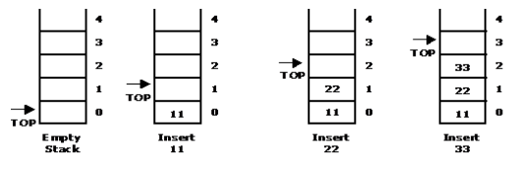
LINKED LIST, STACKS AND QUEUE
When a element is added to a stack, the operation is performed by push().

Slide 71
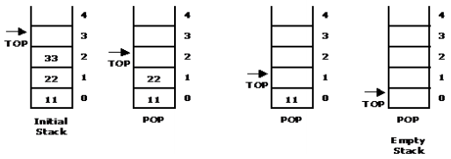
LINKED LIST, STACKS AND QUEUE
When an element is taken off from the stack, the operation is performed by pop().

Slide 72
LINKED LIST, STACKS AND QUEUE
Basic Queue Operations
A queue is a data structure that is best described as "first in, first out".
A queue is another special kind of list, where items are inserted at one end called the rear and
deleted at the other end called the front.

Slide 73
LINKED LIST, STACKS AND QUEUE
A real world example of a queue is people waiting in line at the bank.
As each person enters the bank, he or she is "enqueued" at the back of the line.
When a teller becomes available, they are "dequeued" at the front of the line.

Slide 74
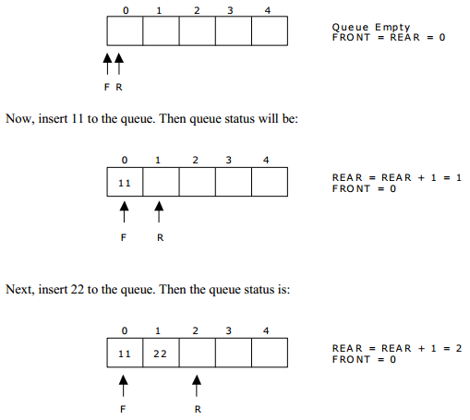
Representation of a Queue using Array
Let us consider a queue with maximum size of 5 elements. Initially the queue is empty.

Slide 75
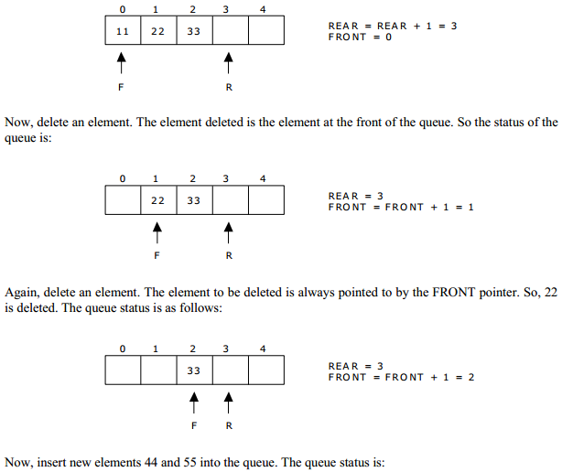
Again insert another element 33 to the queue. The status of the queue is:

Slide 76
LINKED LIST, STACKS AND QUEUE
Next, insert another element, say 66 to the queue.
We cannot insert 66 to the queue as the rear crossed the maximum size of the queue (i.e., 5).
There will be queue full signal.

Slide 77
LINKED LIST, STACKS AND QUEUE
There are various queue operations to perform creation, deletion and display the elements in a queue:
insertQ(): inserts an element at the end of queue Q.
deleteQ(): deletes the first element of Q.
displayQ(): displays the elements in the queue.

Slide 78
Give an example of inserting/deleting 5 elements in/from the queue. Below is the example;

Slide 79
3rd Group Assignemnt
What is Data Structure?
Define & write in full ADT?
Name two data structure fundamental concerns. Who decides which data structures to use? And based on what?
List the examples of data structures.
Give 4 classes of Data structures.
Define Simple Data Structure.
List 5 standard data types of computer languages.
Explain Compound Data structures.
Explain Linear Data Structure.
Outline 5 operations applied on linear data structure.
Give 5 examples of linear data structure.
Describe Non-linear Data Structures.

Slide 80
14. Supply 5 operations applied on non-linear data structures.
15. Outline 4 examples of non-linear data structures.
16. Define a linked list.
17. Give and explain four types of Linked Lists.
18. What is a Double linked list?
19. Explain three fields of a node in the Double linked list.
20. Define a Circular linked list.
21. Discuss a Circular double linked list.

